Slide 1
Data Engineer business case
Javier Serrano Molina

Slide 2
Contents
Introduction
Key facts
Database samples
Timing
Solution
Dashboard
Summary

Slide 3
INTRODUCTION
You are working as a Business Data Engineer, populating data sets in a consistent, fast, and very reliable way. Your daily responsibilities include checking load status, correct transformations, and consistent extractions to solve any issues that arise and complete dashboards and tools.

Slide 4
PRIMARY GOALS
Given the information available, create a dashboard which shows a summary of inventory, demand, and replenishment quantities for the last 60 days. The dashboard should include a breakdown by product and by site, and to see trends over time.

Slide 5
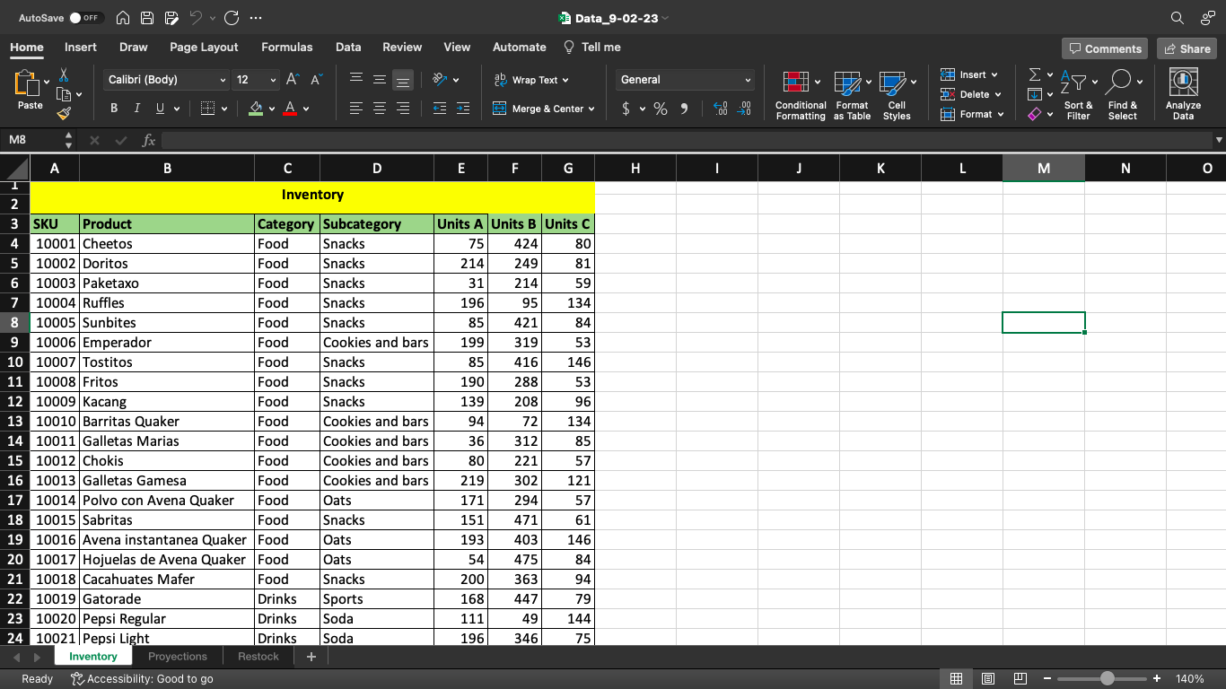
Inventory format

Slide 6
Timing
Inventory Update
12:00 am
Projection update
5:00 am
Replenishment order update
9:00 am

Slide 7
ELT design
Import data
Reorder to represent evolution over time
Add filters
Filter products
Filter sites
Plot
Export plots

Slide 8
Risk areas
Extraction
Missing data
Variant inclusion
Transform
Too many products
Search requires textual product name
Load
Unclear lines
Un-clear trends

Slide 9
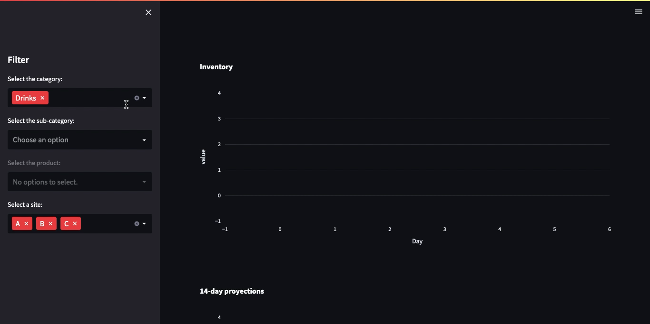
Dashboard

Slide 10
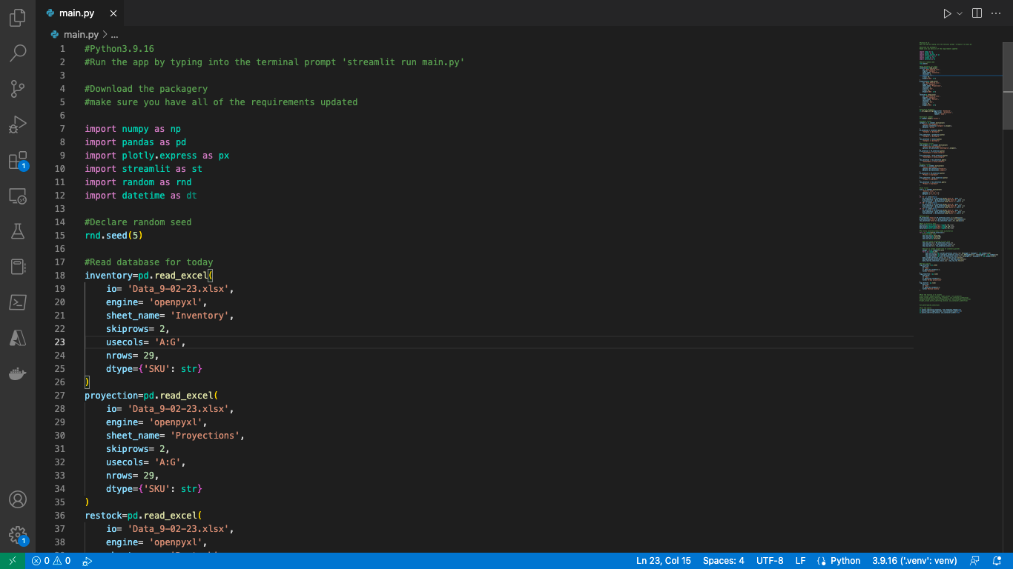
Code sample

Slide 11
THANK YOU
Javier Serrano Molina
jserranomolina@gmail.com

